Slide 1
Udacity Connect Session
April 28, 2018
Deep Learning

Slide 2
Welcome back!

Slide 3
Morning Schedule
10:00 - 10:30 | Housekeeping
10:30 - 11:00 | RL Recap
11:00 - 11:30 | P4 breakdown and roadmap
11:30 - noon | Work on P4
© 2016 Udacity. All rights reserved.

Slide 4
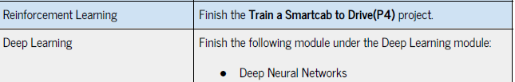

Slide 5
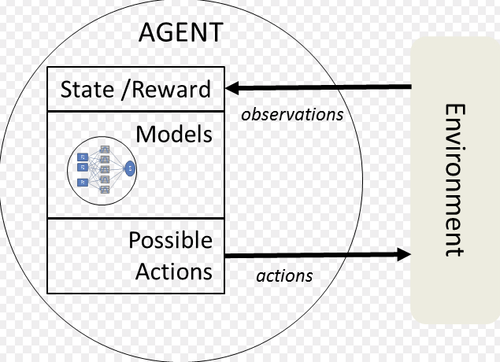
Intelligent Agents - Minimalist

Slide 6
Terminology
DEFINITIONS
STATES
ACTIONS
REWARDS
VALUE
UTILITY
POLICY
VALUE ITERATION
DP/MONTE CARLO
TD LEARNING

Slide 7
State-value
Action-value
V_{𝜋}(s) = E_{𝜋}[G_{t}|S_{t}=s]
q_{𝜋}(s,a) = E_{𝜋}[G_{t}|S_{t}=s, a_{t}=a]
For each state s,
Expected return
If agent starts in state s
Uses the policy 𝜋
To choose actions for all time steps
For each state s and action a,
Expected return
If agent starts in state s
then chooses action a
And Uses the policy 𝜋
To choose actions for all time steps

Slide 8
What if we don’t know MDP?
MODEL-FREE
Sample a number of episodes
Estimate V(s) or Q(s,a) from these samples
Choose a policy based on V(s) or Q(s,a)
Repeat until convergence

Slide 9
TD Learning - Q Learning
Q(S_{t}, A_{t}) ← Q(S_{t}, A_{t}) + 𝛼(R_{t} + 𝛾Q(S_{t+1},A_{t+1}) - Q(S_{t}, A_{t}))
𝛼 - Learning Rate:
𝛼=0 retain memory forever - (never learns)
𝛼=1 remember only immediate reward
𝛾 - Discount Rate
𝛾=0 only consider current state and no history
𝛾=1 retain all future “reward”

Slide 10
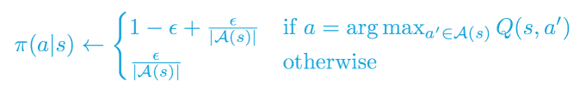
ε - Greedy Policy
Choose action based on max Q(s,a) estimate some of the time (1- ε)
Choose action randomly the rest (ε) of the time
0 < ε < 1

Slide 11
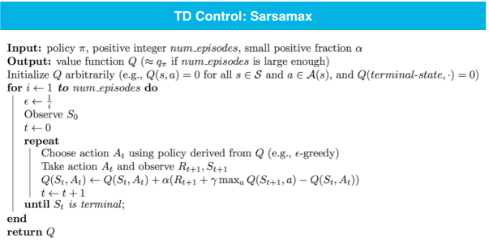
Q - Learning

Slide 12
LearningAgent.update
state = self.build_state() # Get current state
self.createQ(state) # Create 'state' in Q-table
action = self.choose_action(state) # Choose an action
reward = self.env.act(self, action) # Receive a reward
self.learn(state, action, reward) # Q-learn
OBSERVE
ACT
LEARN

Slide 13
LearningAgent.build_state
waypoint = self.planner.next_waypoint()
inputs = self.env.sense(self)
deadline = self.env.get_deadline(self)
state = None # this should be a tuple
return state

Slide 14
LearningAgent.choose_action
self.state = state
self.next_waypoint = self.planner.next_waypoint()
action = None
# changes should go below the TODO
# implement and use the maxQ function to find the action
# with the maximum Q(s,a) value for current state
#
return action

Slide 15
LearningAgent.learn
# implement Q-Learning update here
# project says to set gamma = 0
Notes:
create Q
self.Q[<state>] = {<action>:U, <action>:U,…}
self.Q[<state>][<action>]

Slide 16
LearningAgent.reset
###########
## TO DO ##
###########
# Update epsilon using a decay function of your choice
# Update additional class parameters as needed
# If 'testing' is True, set epsilon and alpha to 0

Slide 17
Controlling the # trials (learning)
##############
# Run the simulator
# Flags:
# tolerance - epsilon tolerance before beginning testing, # default is 0.05
# n_test - discrete number of testing trials to # perform, default is 0
sim.run(n_test=20, tolerance)

Slide 18
Project Implementation Milestones
Implement choose_action with random policy (use random.choice)
Implement build_state, createQ and simple epsilon decay (need to know what variables)
Run simulation with no learning
Should update state on pygame screen, agent should move around
Implement maxQ, update choose_action to implement e-greedy policy
Implement learn and run simulations with learning=True
Should be able to pull in the second set of visuals
sim_default-learning
Update the reset function with a “better” epsilon decay
Run simulations with optimized=True, learning=True
Should be able to pull in the third set of visuals
sim_improved-learning

Slide 19
Work on P4 - next milestone

Slide 20
Lunch Break

Slide 21
Afternoon Session
1:00 - 1:30 | Perceptrons and Neural Networks
1:30 - 2:00 | Gradient Descent and BackProp
2:00 - 2:50 | Keras/TF - Notebook session
2:50 - 3:00 | Recap, Lookahead and Feedback
3:00 - 5:00 | Work on Projects (P3 or P4)
© 2016 Udacity. All rights reserved.

Slide 22

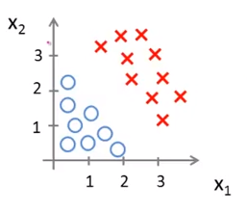
Decision Boundary
CLASSIFICATION
y = w₂x₂ + w₁x₁ + w₀
Weights define a line that best separates the classes
Doesn’t work when class distributions are not linearly separable

Slide 23
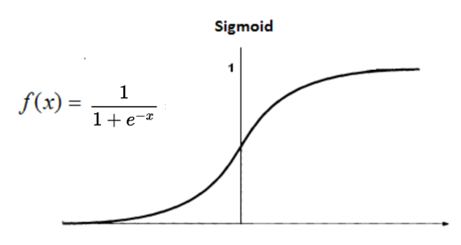
Logistic Regression
Andrew Ng https://www.youtube.com/watch?v=-la3q9d7AKQ
Sigmoid or logistic function
0 < output < 1
Nonlinear
Interpret as probability
Threshold for classification

Slide 24
Structure of a Perceptron
http://neuralnetworksanddeeplearning.com/
x₁
w₁
x₁
w₁
W^{T}x
a(W^{T}x)
x₂
w₂
x₂
w₂
w₃
w₃
x₃
x₃

Slide 25
Activation Functions
Linear or Nonlinear
Possible input values float -∞ ≤ x ≤ ∞
Range (output) float 0 ≤ a(x) ≤ 1

Slide 26
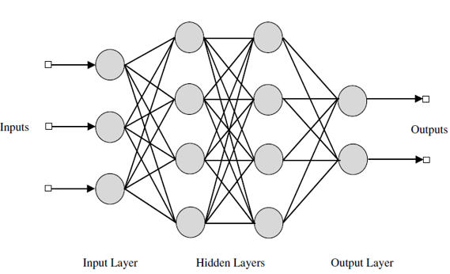
Network of Perceptrons
Input
Bias
Output
Hidden
1
1
1
Notes:
In this architecture, it is important to note that every node is connected to every other node in next layer & and there are no connections between one to the next layer node (depth =1)

Slide 27
Notation
W₁x₁ + w₂x₂
x₁ w₁
x₂ w₂
x₁
a⁽¹⁾
W^{T}x
x₂

Slide 28
Notation
w₁₁x₁ + w₁₂x₂
w₂₁x₁ + w₂₂x₂
x₁ w₁₁ w₁₂
x₂ w₂₁ w₂₂
w₁₁
W₁^{T}x
W₂^{T}x
x₁
a⁽¹⁾
w₂₁
a⁽²⁾
x₂
a⁽¹⁾
W^{(1)T}x
a⁽²⁾ ⊗ W⁽²⁾ ⊗ a⁽¹⁾ ⊗ W⁽¹⁾ ⊗ x

Slide 29
Matrix Dimensions
MATRIX MULTIPLICATION RULES
W_{ij} x W_{jk} -> W_{ik}
First index - number of units in the layer
Second index - number of outputs in the next layer
Number of units = number of perceptrons (features) + bias unit
Number of parameters - ij + jk + ..

Slide 30
Predictions and Cross-Entropy
Output layer activation Softmax = e^{x}/(1+e^{x})
Single class cross-entropy: 𝝨_{i} -p_{i}log(p_{i}) - (1-p_{i})log(1-p_{i})
Multi-class cross-entropy: 𝝨_{k} 𝝨_{i} -p_{ik}log(p_{ik})
i = count over all examples
k = count over all classes

Slide 31
Gradient Descent
MINIMIZE CROSS-ENTROPY
Chain rule of differentiation -- changes function composition into products
g(f(x)) -> g’(f)f’(x)
Choose weights
Calculate the predictions (probabilities)
Calculate the error function -- cross-entropy
Find the gradient (derivative) of the cross-entropy
Adjust weights (learning rate) in the direction of steepest descent
Repeat until convergence

Slide 32
Considerations
Large datasets may not fit in memory - stochastic gradient descent
Isn’t guaranteed to converge
Gradients can get very small - vanishing gradient
Lots of parameters in a complex network
Overfitting?

Slide 33
Tensors
ADD, SUBTRACT, MULTIPLY, derivatives
High-dimensional arrays
Each additional dimension is an array of lower-dimensional objects
0-dimensional tensor - “scalar”
1-dimensional tensor - “vector” array of scalars
2-dimensional tensor - “matrix” array of vectors
3-dimensional tensor - array of matrices
4-dimensional tensor - matrix of matrices

Slide 34
TENSORFLOW
Tensorflow
Library for tensor math and manipulation
Put out by Google
Define a series of operations -- build a graph of operations
Compute the graph (“run”)
Can run on CUDA compatible GPUs with no additional effort
PyTorch
Similar to TF, contributed by Facebook

Slide 35
Keras
Wrapper for tensor manipulation libraries - Theano and Tensorflow
More intuitive - Layers for defining NN layer
sklearn - like interface
Model
Fit
Makes it very easy to build and use NN architectures

Slide 36
Activate your python 3 environment
conda install keras, tensorflow
May need to install them separately
Start your jupyter session

Slide 37
github.com/Udacity/machine-learning/projects
/practice_projects/imdb/Student_Admissions

Slide 38
Prep for next week
Complete Smartcab Project (P4) due 4/28/18
Deep Neural Networks (Lesson 1) - complete
Convolutional Neural Networks (Lesson 2) pts 1-17
We will do the mini-project in class next weel

Slide 39
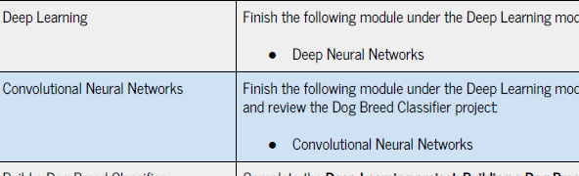

Slide 40

We really need your Feedback!
© 2016 Udacity. All rights reserved.

